Slide 1



Furriend: A Mobile Pet Sitting Application for Filipino Pet Owners
Leader: John Paul Penola
Members:
Ambong, Vincent Redd
Fernandez, Lance Cedrick
Hernandez, Mark
Libag, Joshua
Milestone 4

Slide 2
Our Logo
The Furriend logo features a friendly and playful design that reflects the heart of the brand—trust, care, and companionship. The icon combines a paw print and a smiling face, symbolizing both pets and the warm, supportive connection between owners and sitters. Its rounded shapes and soft edges express approachability and comfort, making the brand feel safe and welcoming.
The use of a bright orange color reinforces Furriend’s personality: energetic, friendly, warm, and community-driven. The custom lettering beside the icon is smooth and modern, mirroring the app’s simple and reliable service. Overall, the logo captures Furriend’s mission to connect pet lovers with trusted sitters through a joyful and trustworthy experience.

Slide 3



Who we are
Name of your Venture: Furriend - A simple application connecting pet owners with sitters in the Philippines.
Why ?
Explain why do you want to pursue this Business Idea.
In the Philippines, pet ownership is rapidly growing, especially among millennials and Gen Z in urban areas. However, pet owners struggle to find reliable, affordable, and trustworthy pet care options when they are at work, traveling, or unavailable.
What ?
Provide a brief on what does your venture do.
Furriend is a mobile app that connects pet owners with trusted, verified sitters in their area. Pet owners can create detailed pet profiles, browse sitter reviews, book services, chat, and pay securely—all in one platform. With real-time photo and video updates, Furriend ensures peace of mind while empowering a community of pet lovers to provide safe, reliable, and affordable pet care.
How ?
Explain how your venture solves the problem and make its revenue.
Furriend solves the problem of unreliable and expensive pet care in the Philippines by connecting pet owners with trusted, verified sitters through a convenient mobile app. Instead of relying on busy relatives, costly vet boarding, or unverified sitters, owners can easily book safe, affordable, and flexible pet care while receiving real-time photo and video updates for peace of mind. The venture generates revenue through a small booking commission (10–15%), premium sitter profiles for boosted visibility, an in-app pet care marketplace, sponsored ads from pet brands, and optional subscription plans offering added benefits like discounts and emergency vet support.

Slide 4
Problem/Opportunity
Name: Jeffrey Lobaton
Problem: Struggle to find reliable, affordable, and trustworthy pet care options when I’m at work, traveling, or unavailable.
CONTEXT When does the problem occur? The problem usually happens when I’m at work for long hours, during overnight shifts, or whenever I need to travel. I also feel it on weekends if I have social events, since I can’t always bring my pet with me. Basically, it occurs any time I can’t be physically present to care for my pet. | PROBLEM What is the root cause of the problem? The root cause is that there are very few reliable and affordable pet sitting services in the Philippines. Most options are either informal (asking friends or neighbors) or expensive (boarding at a vet or pet hotel). There’s no centralized, trustworthy system to find sitters who are verified and available when I need them. | ALTERNATIVES What do customers do now to ﬁx the problem? Right now, I usually rely on family or neighbors, but they are often busy or forgetful. Sometimes I use vet boarding, but it’s costly and stressful for my pet. If I can’t find anyone, I just leave food and water out and hope for the best, which makes me really anxious.
CUSTOMERS Who has the problem most often? I think this problem is most common among pet owners in urban areas like Manila, especially young professionals, call center agents, nurses, and students who have irregular or long schedules. Basically, anyone who works away from home a lot and owns a pet faces this problem. | EMOTIONAL IMPACT How does the customer feel? I feel anxious and guilty when I leave my pet behind. | ALTERNATIVE SHORTCOMINGS What are the disadvantages of the alternatives? Family and neighbors are unreliable since they have their own priorities. Vet boarding is expensive and stressful for my pet. Leaving food and water out isn’t safe because it doesn’t guarantee my pet is properly cared for. Basically, none of the alternatives give me the peace of mind I really want.
CUSTOMERS Who has the problem most often? I think this problem is most common among pet owners in urban areas like Manila, especially young professionals, call center agents, nurses, and students who have irregular or long schedules. Basically, anyone who works away from home a lot and owns a pet faces this problem. | QUANTIFIABLE IMPACT What is the measurable impact (include units)? Based on what I’ve seen, around 70% of my friends who have pets also struggle to find sitters. Sometimes I even cancel travel plans or turn down extra work shifts because I don’t want to leave my pet alone, which affects my income and opportunities. | ALTERNATIVE SHORTCOMINGS What are the disadvantages of the alternatives? Family and neighbors are unreliable since they have their own priorities. Vet boarding is expensive and stressful for my pet. Leaving food and water out isn’t safe because it doesn’t guarantee my pet is properly cared for. Basically, none of the alternatives give me the peace of mind I really want.
‹#›

Slide 5
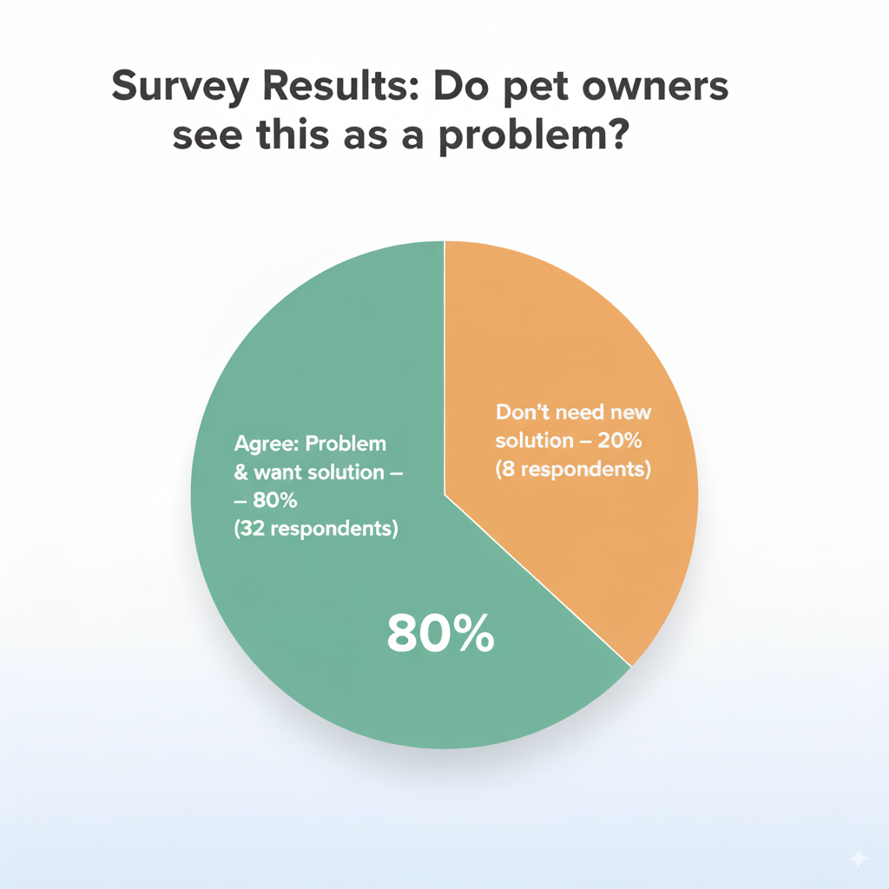
Problem Interviews And Surveys Results
We conducted a survey with 40 pet owners in the Philippines through Google Forms to better understand the challenges in finding reliable pet care.
Demographics of respondents:
  Age: Majority were 18–35 years old (65%), followed by 36–50 years old (25%), and 51 years old and above (10%).
  Gender: 70% female and 30% male.
  Type of pets owned: Dogs (75%) were the most common, followed by cats (50%), and a smaller percentage owned other pets such as birds, hamsters, or fish (15%).
Key Findings:
  32 respondents (80%) agreed that finding reliable pet care is a real problem and expressed strong interest in a new solution, such as a mobile application that connects them to verified pet sitters.
  8 respondents (20%) indicated that they do not feel the need for a new solution, as they are currently satisfied with their existing arrangements (e.g., relying on family, neighbors, or vet boarding).
Insight:
The results highlight that a significant majority of pet owners (4 out of 5) are actively looking for more trustworthy and convenient options for pet care, especially those with busy lifestyles and multiple pets. This validates the potential demand for a pet-sitting mobile app in the Philippine market.

Slide 6
Market Size Estimation
₱60B – Total Addressable Market: All pet-owning households in the Philippines (~12M)
How did we calculate the market size?
1. Start with Total Addressable Market (TAM)
  94% of Filipino households own pets (Trade.gov / Kantar).
  About 12M pet-owning households (Dogster, 2024).
  If each spends ₱5,000/year on pet services →
  TAM = ₱60 Billion/year (~$1B USD).
  2. Take your target market (SAM)
  Narrow down to urban areas where Furriend can realistically operate.
  Focus: Metro Manila, Cebu, Davao (~30% of households = ~4M).
  At ₱5,000/year spending →
  SAM = ₱20 Billion/year (~$350M USD).
  3. By conducting research with existing competitors, distributors etc., understand the likely penetration rate
  Since no centralized sitter app currently exists in PH, but looking at benchmarks like Rover (US) and PetBacker (SG), a conservative 2% adoption rate of SAM is realistic in 3–5 years.
  4. Multiply target market by penetration rate to find your market size
  2% of SAM (₱20B) = ₱400M/year (~$7M USD) gross bookings.
  With Furriend’s 10–15% commission fee → ₱40–60M/year (~$700k–$1M USD) in actual revenue.
₱20B – Serviceable Available Market: Urban households in Metro Manila, Cebu, Davao (~4M)
.
₱400M – Serviceable Obtainable Market: Furriend’s target share (2%)

Slide 7
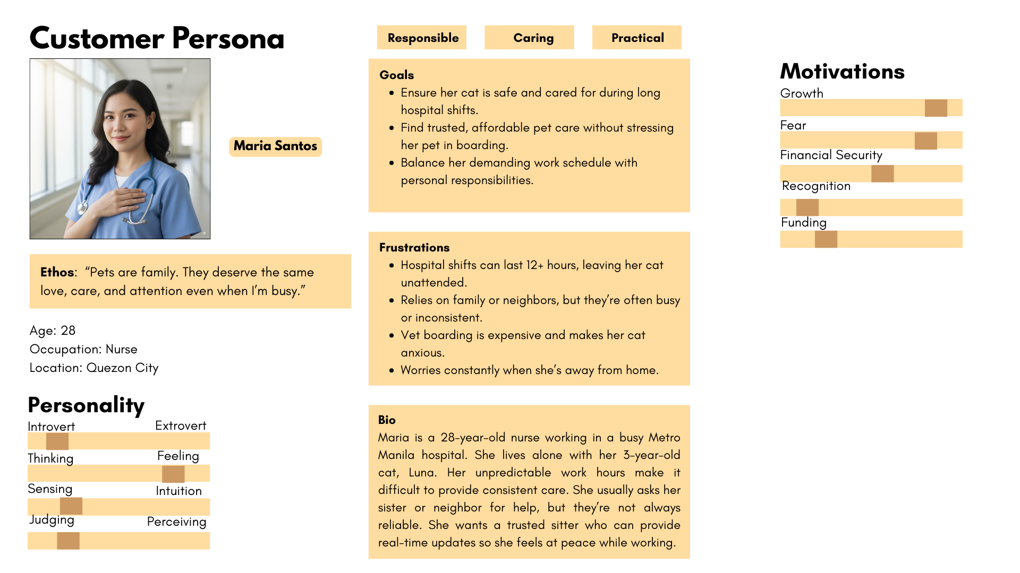
Notes:
‹#›

Slide 8
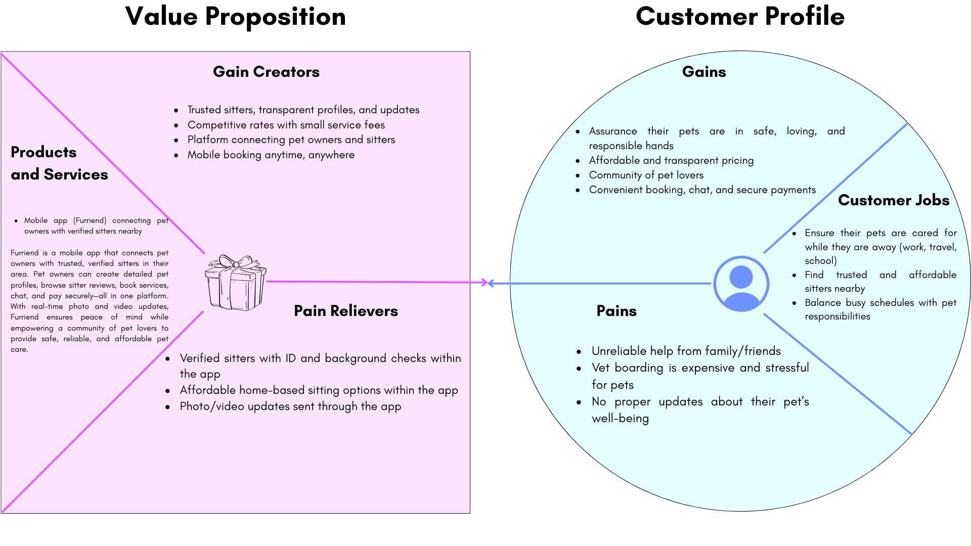
Value Proposition Canvas
Notes:
‹#›

Slide 9
Solution
Describe your Solution:
We offer a mobile application called Furriend that connects pet owners with trusted and verified sitters nearby, providing a safe, affordable, and convenient way to ensure pets are cared for when their owners are busy, traveling, or unavailable.
The details of our offering consist of:
  Verified Sitter Profiles – Sitters undergo verification, with ratings and reviews available for transparency.
  Pet Profiles & Booking System – Owners create detailed pet profiles (breed, age, needs, behavior) and schedule services through the app.
  In-App Chat, Updates, and Secure Payments – Owners can chat with sitters, receive photo/video updates, and pay securely in-app.
  Pet Care Marketplace – In-app store for pet food, toys, grooming supplies, and accessories.
  Premium Services – Subscription plans offering discounts, insurance, and emergency vet support.
List the Benefits of Your solutions
Verified Sitter Profiles → Builds trust and peace of mind, ensuring pets are in safe hands.
  Verified Sitter Profiles → Builds trust and peace of mind, ensuring pets are in safe hands.
  Pet Profiles & Booking System → Provides personalized care and makes scheduling fast and convenient.
  In-App Chat, Updates, and Secure Payments → Gives owners real-time assurance and hassle-free transactions.
  Pet Care Marketplace → Offers one-stop convenience for pet needs without leaving the app.
  Premium Services → Ensures added security, savings, and emergency support for responsible pet ownership.
Notes:
Evaluation Criteria for slides 8 and 9
Check the following on the correctness of VPC:
a. Have you identified the correct pains & gains; pain relievers & gain creators (2 marks)
b. Have you identified the correct Jobs-to-be-done? (1 mark)
c. Are the pain relievers addressing the customer pains? (1 mark)
d. Have you identified the right value proposition so that the solution makes the customer's life better? (1 mark)
‹#›

Slide 10
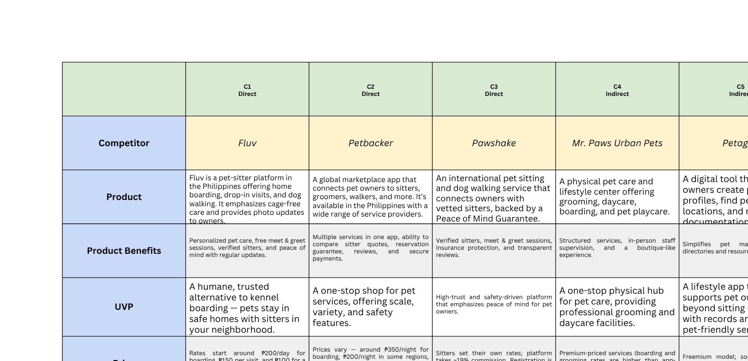
Competition Analysis

Slide 11
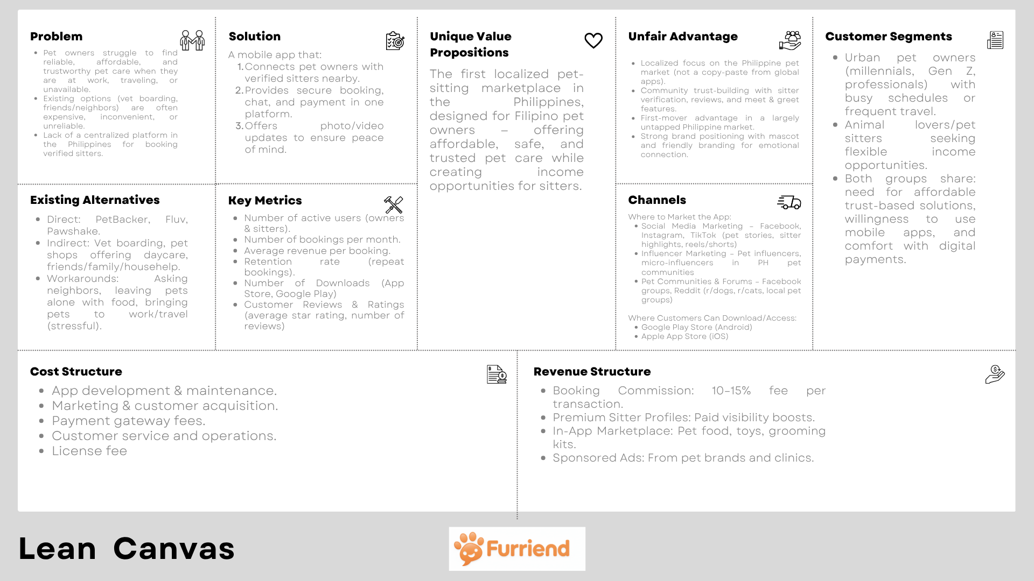

Slide 12
MVP of Furriend (Mobile Application)
Prototype link: Furriend

Slide 13
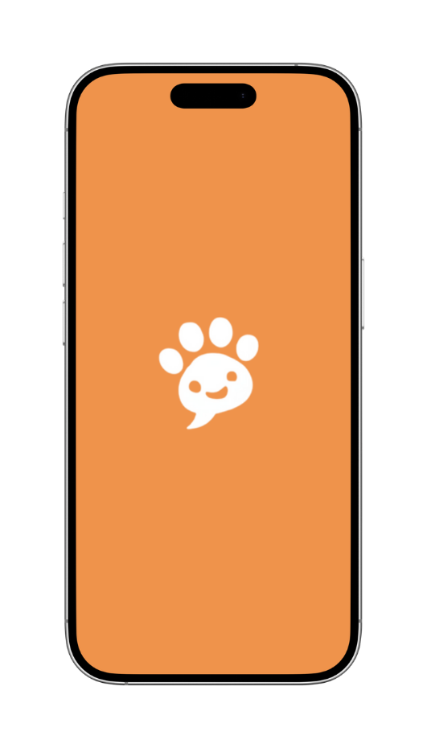
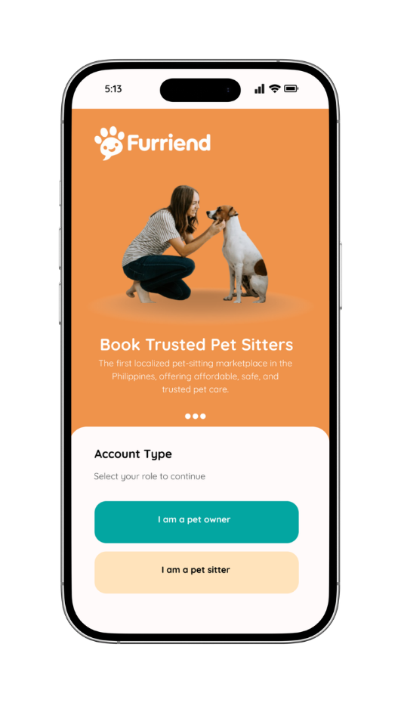
1. Splash Screen
The first screen users see when opening the app. It displays the Furriend logo with subtle animation. Creates brand recall and transitions smoothly to the login/onboarding flow.
2. Choose Account Type Screen
This screen helps new users identify their role in the app. Users select whether they want to use the app as a Pet Owner (to book services) or a Pet Sitter (to offer services).

Slide 14
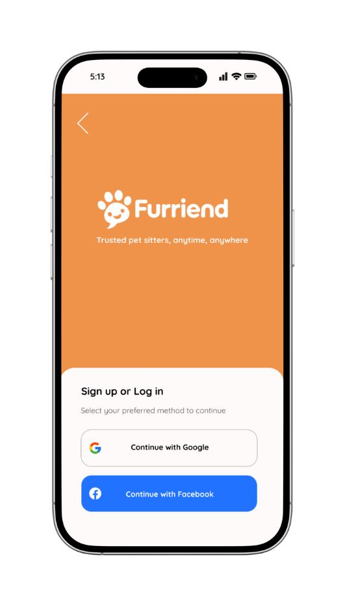
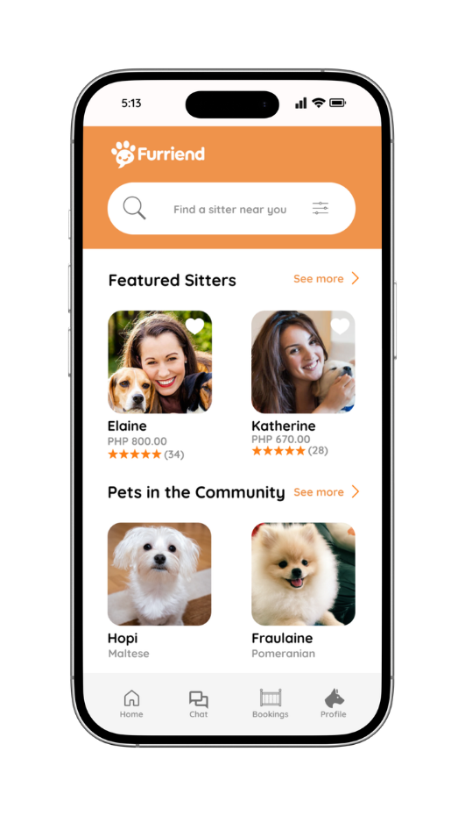
3. Login/Signup
This is the entry point for all users — whether they’re Pet Owners or Pet Sitters. They have two options to login which is either with Google or Facebook.
4. Pet Owner Dashboard
The hub for pet owners. Includes a search bar for nearby sitters, a filter system (location, price, rating, services), and featured sitter cards with quick booking details. Bottom navigation keeps essentials within reach.

Slide 15
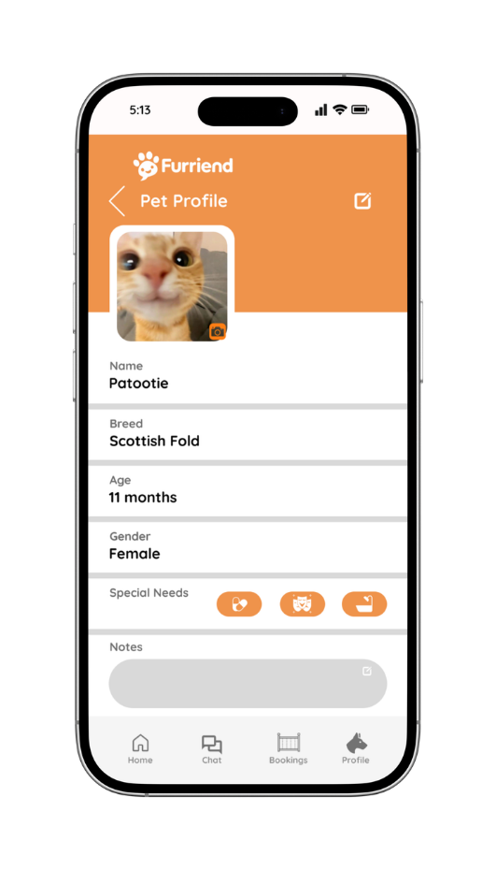
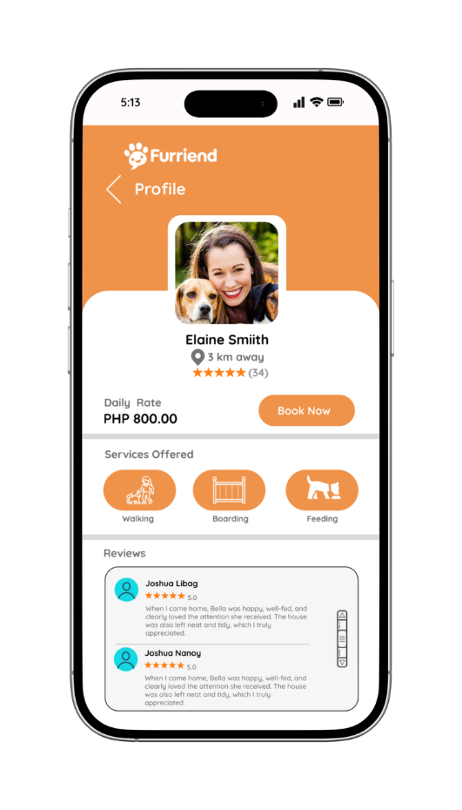
5. Pet Profile (Pet Owner)
A dedicated space to manage pet details. Owners can upload a pet photo, input details like name, breed, age, and gender, and mark special needs via dropdown. A notes section allows feeding instructions, allergies, or habits. Saved profiles simplify future bookings.
6. Sitter Profile (Pet Owner)
Displays a sitter’s information clearly: photo, name, location, distance, ratings, rates, and services offered. Owners can scroll through reviews from other pet parents. The “Book Now” button provides a direct action for conversion.

Slide 16
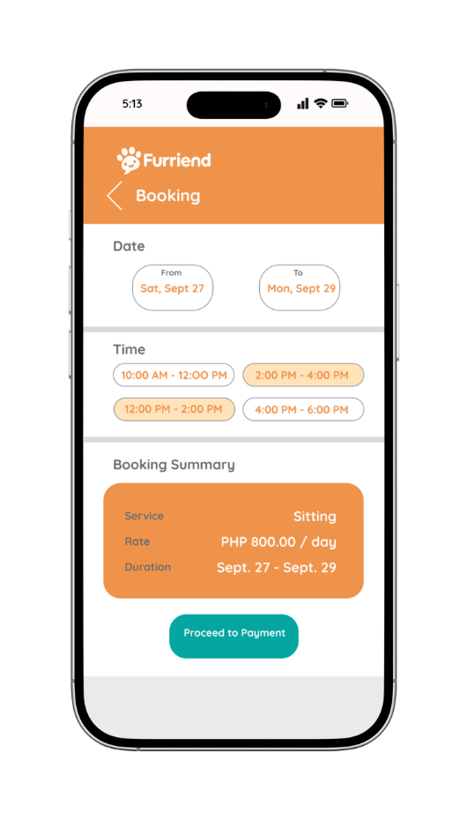
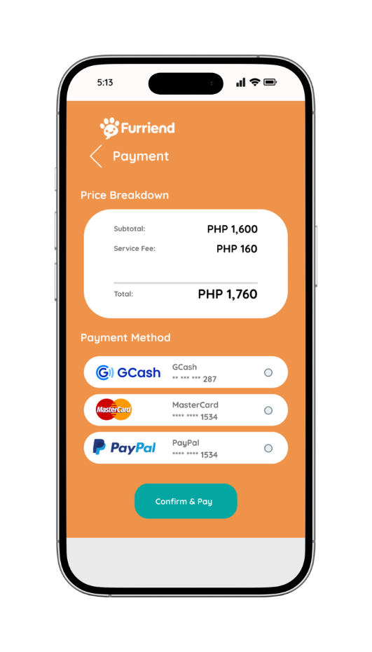
7. Booking (Pet Owner)
Guides owners through booking. Features a calendar picker, time slot selector, and a summary of services and costs
8. Payment (Pet Owner)
Payment options include GCash, debit/credit card, and PayPal. A clear Confirm & Pay button finalizes reservations.

Slide 17
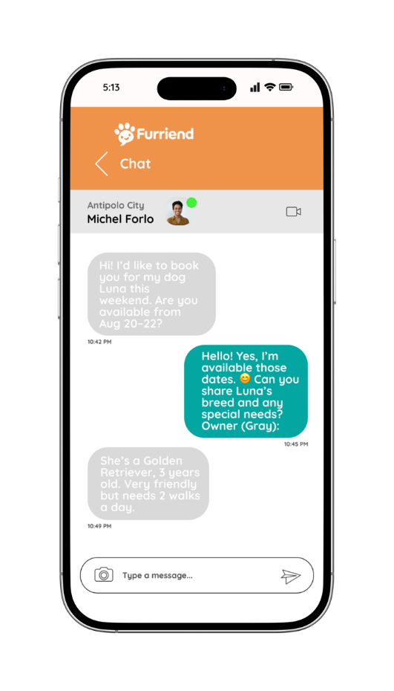
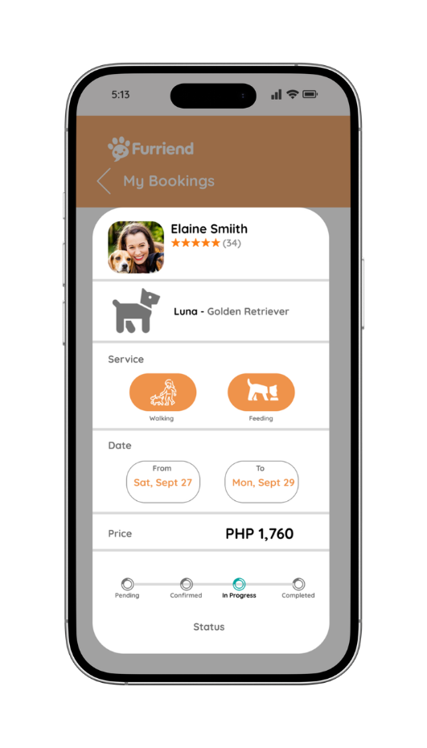
9. Chat / Messaging
Enables direct communication with sitters. Owner messages appear on the right, sitter on the left. Includes photo/video sharing, and status indicators (online/offline) for transparency.
10. Booking Status (Pet Owner)
Keeps owners updated on their bookings. Shows sitter, pet, date, time, and service with a status tracker (Pending, Confirmed, In Progress, Completed).

Slide 18
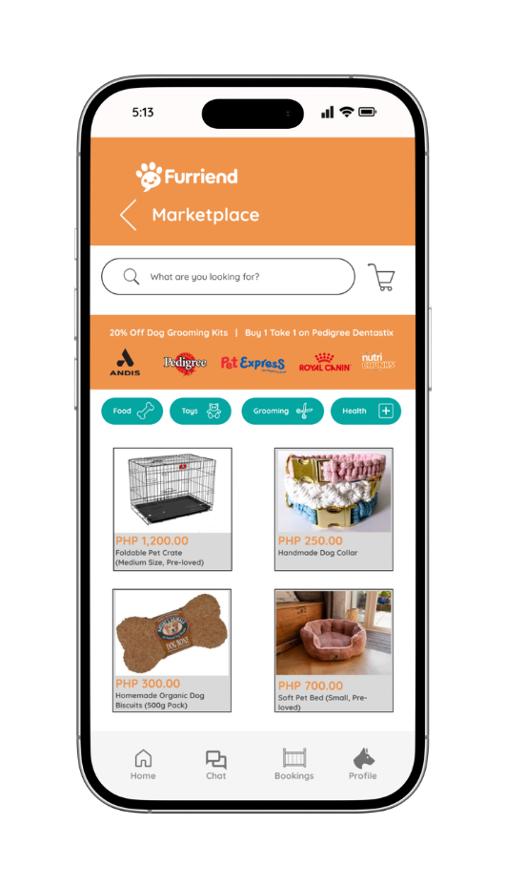
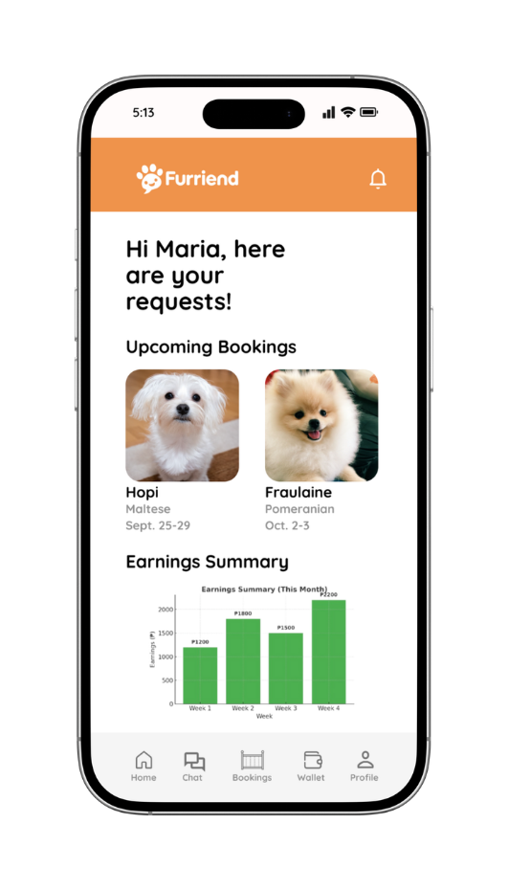
11. Marketplace (Pet Owner)
A peer-to-peer store where owners can buy or sell pet-related items. Includes featured ads (e.g., sponsored by pet brands), P2P product listings with photos, price, and seller info, and filter/search options. Encourages community engagement beyond services.
12. Sitter Dashboard (Sitter)
Personalized with a welcome message and overview of upcoming bookings, earnings summary, and notifications (new requests, reviews). Bottom navigation ensures quick access to Home, Chat, Bookings, Wallet, and Profile.

Slide 19
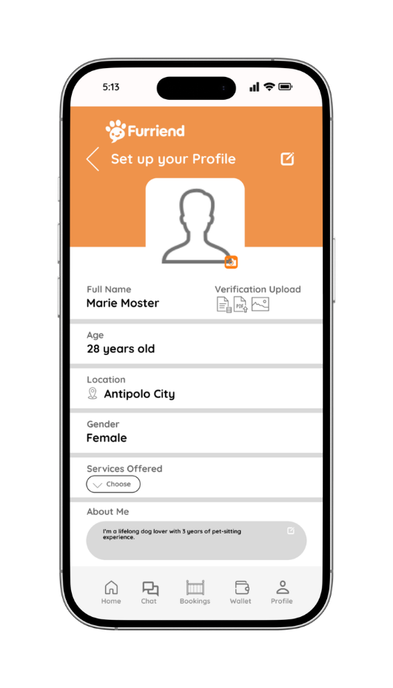
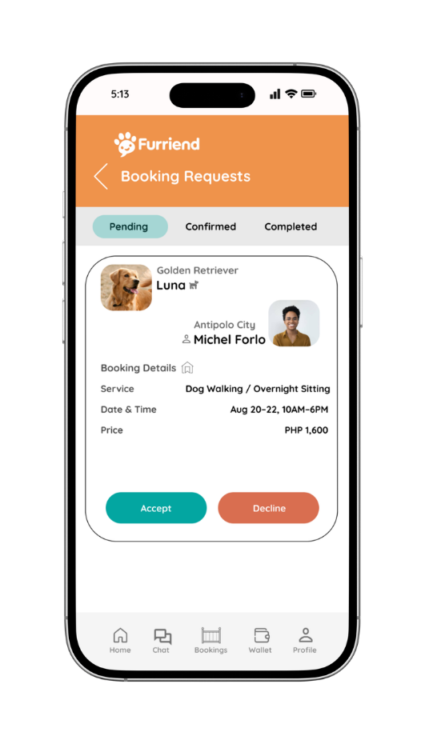
13. Sitter Profile (Sitter)
Sitters build credibility by uploading a profile photo, entering basic info, writing a short bio, and selecting services offered with custom rates. They can also upload verification documents for trust and safety.
14. Booking Requests (Sitter)
Lists incoming booking requests with pet photo, owner info, location, rating, and service details. Sitters can Accept or Decline requests. Tabs for Pending, Confirmed, Completed make request management straightforward.

Slide 20
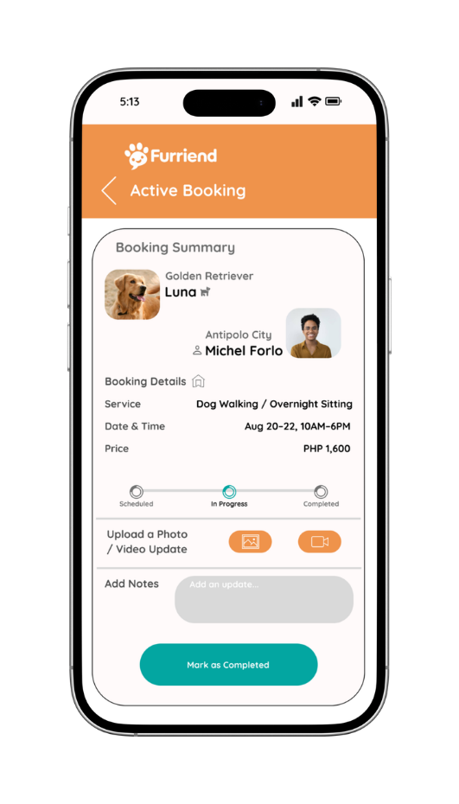
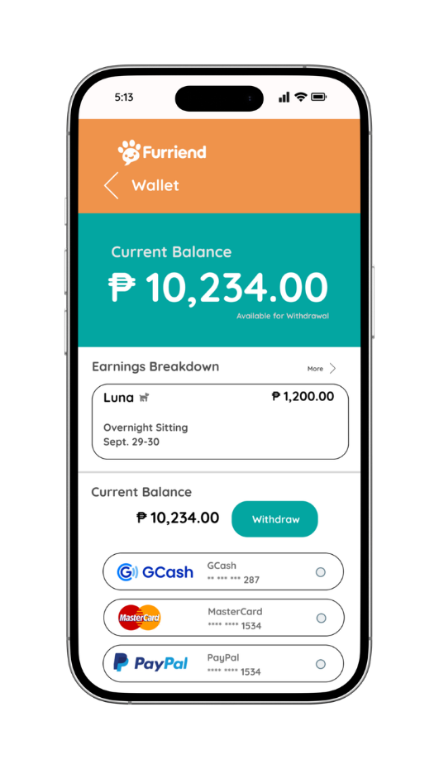
15. Active Booking Management (Sitter)
A control panel for ongoing jobs. Displays booking details (pet, owner, schedule) with a status toggle from Scheduled → In Progress → Completed. Sitters can upload photos/videos as updates and add notes for owners.
16. Wallet Earnings (Sitter)
Tracks sitter earnings in real time. Shows current balance, earnings breakdown. Sitters can withdraw via GCash, bank transfer, or PayPal. Keeps financial transparency simple.

Slide 21
MVP Validation
1. What is your MVP? (Product Details)
Our Minimum Viable Product (MVP) is a pet care and pet-sitting mobile application called Furriend. It connects pet owners with trusted sitters, walkers through a two-sided marketplace. Core features include:
  Booking System – schedule and manage services like pet sitting, dog walking, and grooming.
  Marketplace – P2P listings for pet products and essentials.
  Wallet & Payments – cashless transactions via GCash, bank transfer, or PayPal.
  Ratings & Reviews – ensure sitter quality and trust.
  Safety & Verification – sitter profile validation and ID verification.
Conclusion:
Persevere - The results showed strong customer interest (85% willing to buy, 80% willing to recommend) and openness to the proposed service fee. This validates that our MVP has a promising product–market fit.
2. Who is the Target Market?
  Primary Users: Pet owners in urban areas (Metro Manila, Cebu, Davao) who have busy schedules and need safe, convenient, and reliable pet care.
  Demographics: Young professionals, working parents, and middle-class households (ages 20–40) who treat their pets as family and are willing to spend for their well-being.
  Secondary Users: Students and young adults looking for part-time income by becoming verified pet sitters.
3. How Will We Get to That Target Market?
We will use a mix of digital marketing, partnerships, and community-driven growth:
  Digital Marketing & Social Media
    Pet owner communities on Facebook Groups, TikTok, Instagram, and YouTube Shorts.
    Targeted ads focusing on convenience, trust, and affordability.
  Partnerships
    Tie-ups with veterinary clinics, pet supply stores, and grooming salons to promote the app.
  On-ground Pet Community Events
    Join pet fairs, adoption events, and vet outreach programs to promote the brand directly to pet owners.
  App Distribution
    Available on Google Play Store and Apple App Store, with early adoption perks.
Results of MVP Validation (40 Respondents)
1. How many customers are willing to buy the product?
Out of 40 respo ndents, 34 said they are willing to use and buy the service.
That is 85% willingness, showing strong product-market fit (more than 80%).
Realizations / Insights:
  Pet owners are highly concerned with safety and trust, so sitter verification and background checks are essential.
  Customers are price-sensitive for shorter services, suggesting the need for flexible or tiered pricing models.
  The marketplace for pet products adds extra value but should feature affordable, local brands to appeal to Filipino consumers.
  Many respondents see the product as unique and innovative, filling a real gap in pet care services.
2. Are customers willing to pay for the product (10%-15% per booking commission fee)? Why or why not?
  Yes (34 respondents, 85%) – They believe the price is fair given the convenience, safety, and time saved.
  No / Not Sure (6 respondents, 15%) – Some suggested cheaper rates for short bookings or package deals.
3. Comments or Suggestions to Improve the Product:
  Add 24/7 emergency vet hotline inside the app.
  Provide insurance coverage for pets during sitter services.
  Offer subscription packages for frequent users (weekly walks, monthly grooming).
  Expand marketplace with more affordable local brands.
Next Steps:
  Refine Features – strengthen sitter verification, explore pet insurance options, and add subscription packages.
  Pilot Launch – release the MVP in Metro Manila first to test adoption and operations.
  Partnerships – collaborate with veterinary clinics, grooming salons, and pet stores to build trust and visibility.
  Marketing Campaign – focus on social media pet communities, influencer collaborations, and referral programs.
  Collect Feedback – continue surveys, user testing, and in-app feedback to guide iteration.
4. Will customers recommend the product to others? Why or why not?
  Yes (32 respondents, 80%) – They see the app as helpful, innovative, and filling a gap in the market.
    Reasons: Trustworthy sitters, convenience, and safe cashless payments.
  No / Not Sure (8 respondents, 20%) – Mostly due to concerns on sitter reliability and app credibility (since it’s still new).

Slide 22
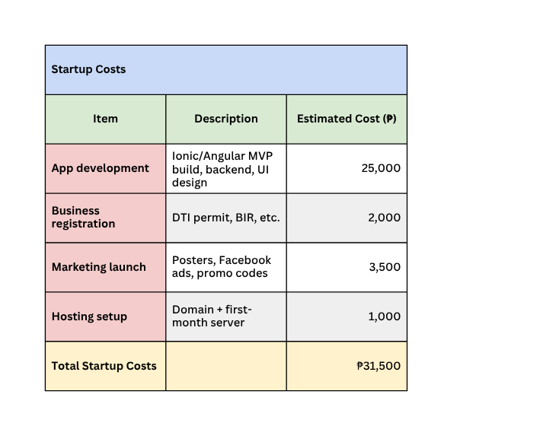
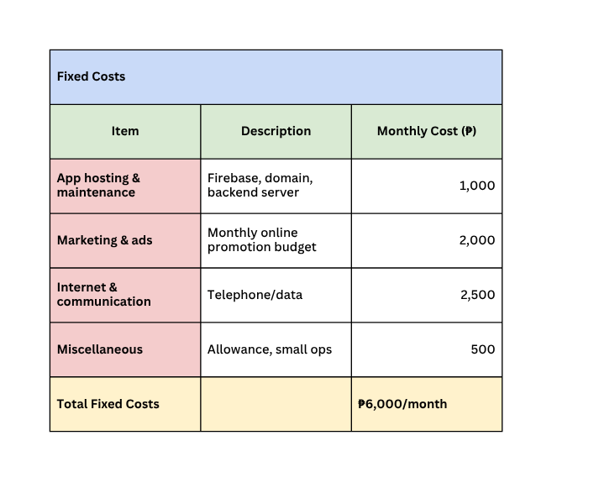
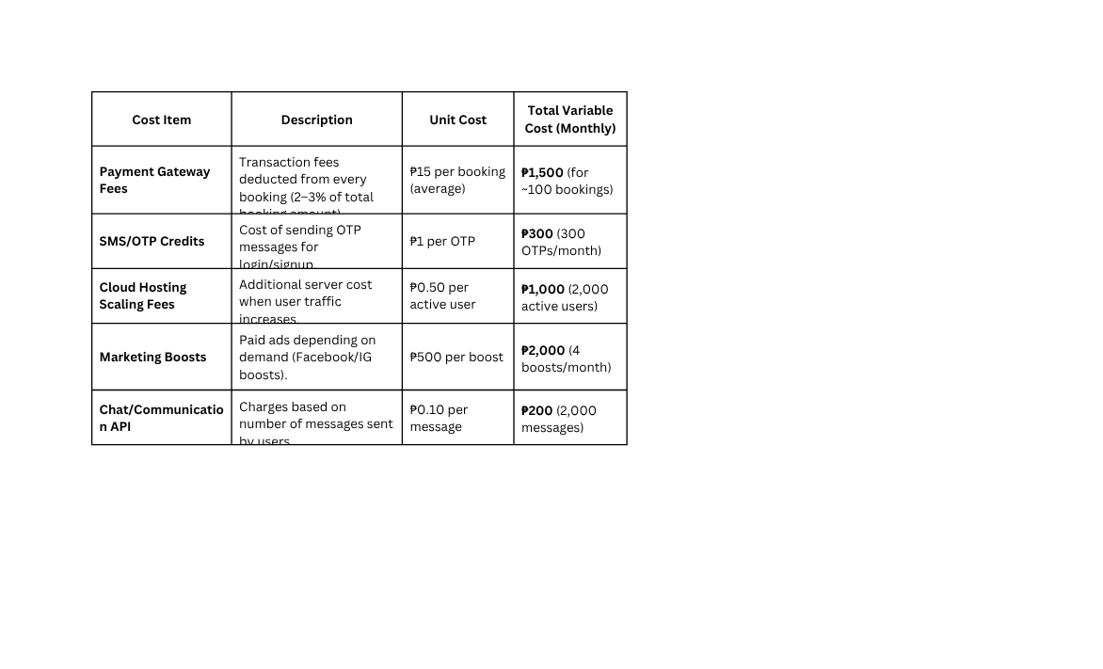
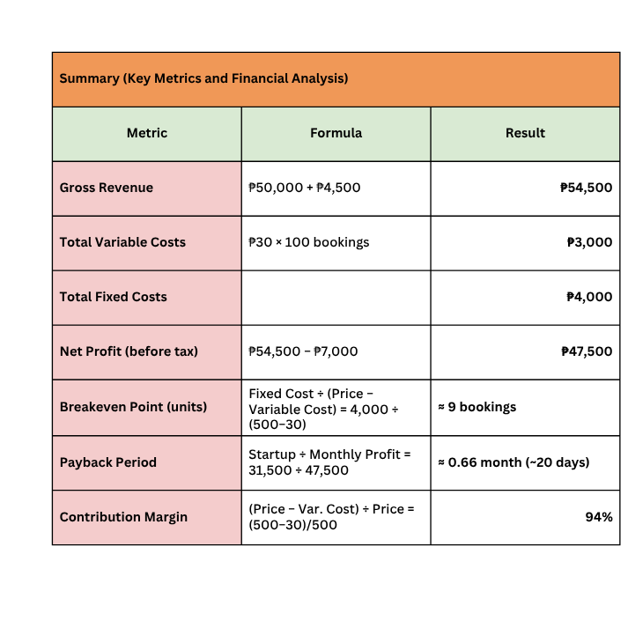
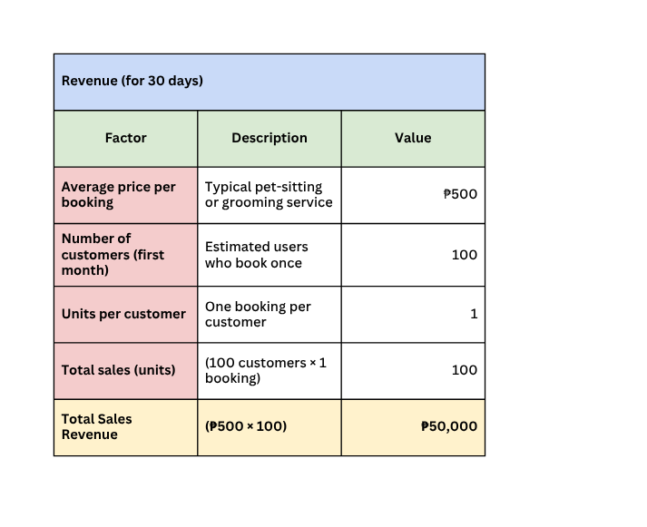
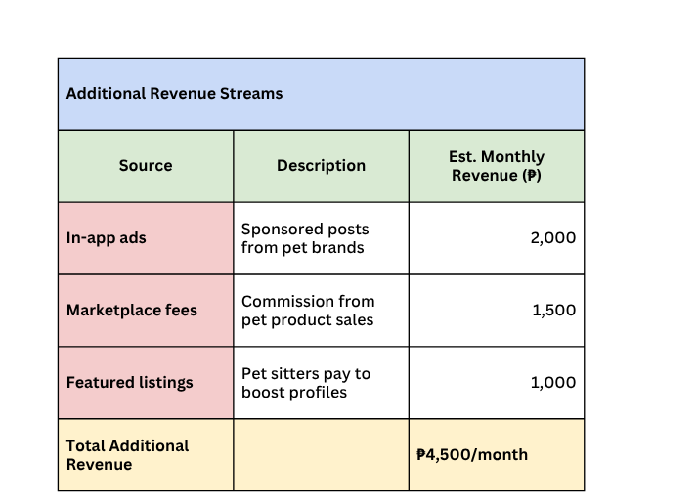
Financial Breakdown and Plan
Variable Costs

Slide 23



Go-to-Market Strategy
Social Media Presence
Platform | Purpose | Sample Content
 | Primary community hub; run targeted ads for pet owners | Pet care tips, sitter highlights, customer stories
 | Visual storytelling platform | Reels of happy pets, sitter experiences, feature promos
 | Reach younger audience through fun short-form content | Quick pet hacks, funny clips with mascot, sitter intros

Slide 24
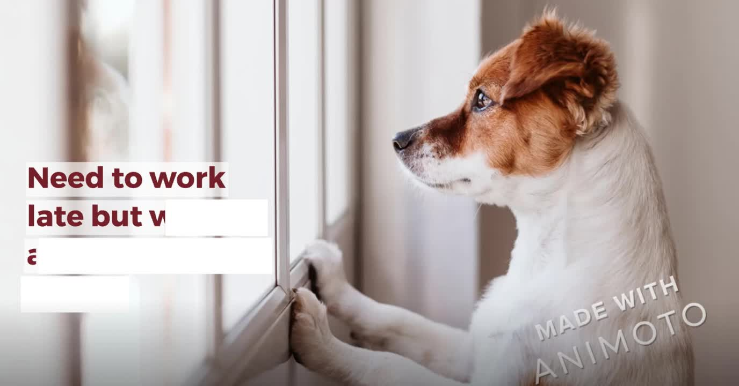
Go-to-Market Strategy
Branding Video - Furriend - Branding Video

Slide 25
Go-to-Market Strategy
Positioning Statement
PetAlaga PH is a mobile platform that connects pet owners with trusted local pet sitters and service providers, offering a safe, convenient, and affordable way to care for pets anytime, anywhere.
Unique Value Proposition:
  Simplifies pet care through on-demand, location-based sitter matching
  Builds trust via verified sitters and transparent reviews
  Supports small pet-related businesses through marketplace integration

Slide 26
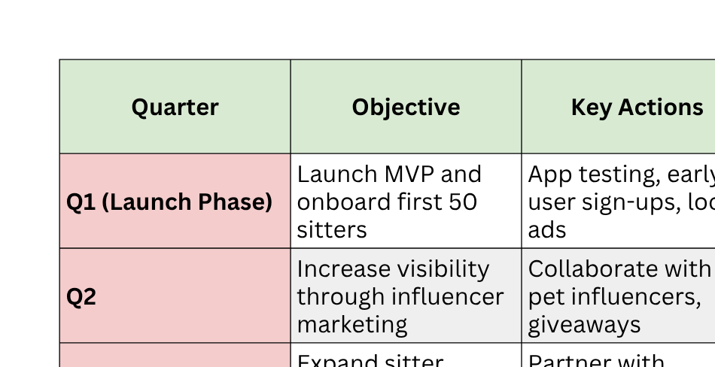
Go-to-Market Strategy
Action Plan (12-Month Roadmap)

Slide 27
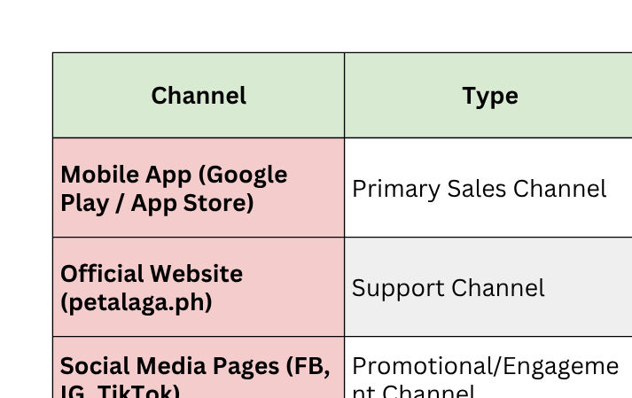
Go-to-Market Strategy
Sales & Distribution Model
Sales Model:
  10–15% commission per successful booking
  Optional sitter subscription for premium listing visibility
  Additional income from sponsored ads and in-app promotions

Slide 28
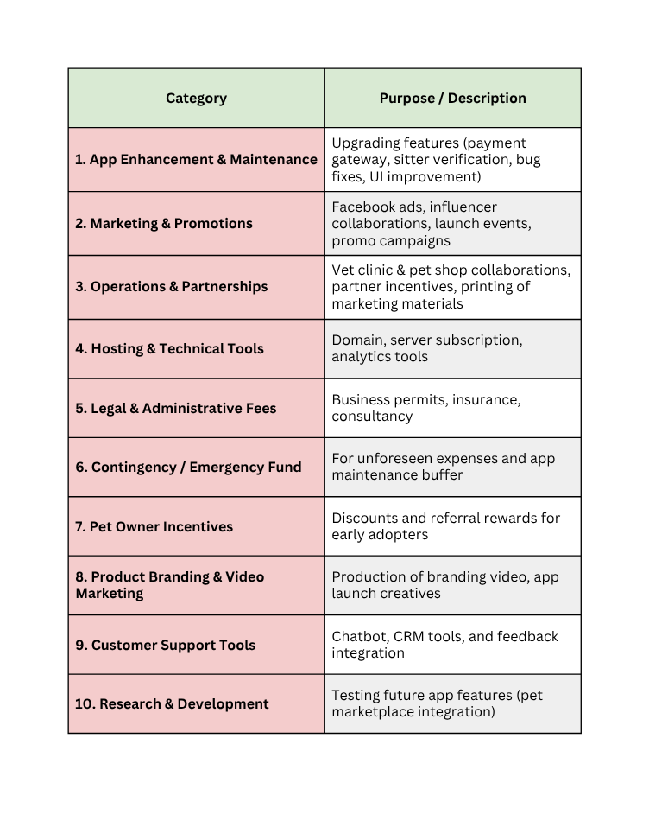
Funding Plan
How much funds required to reach the next level of the venture?
  To reach our next stage (official app launch + first 6 months of operations), we originally required ₱150,000 in funding.
  After adding an additional one-third (₱50,000) as a buffer for scaling, unforeseen costs, and accelerated marketing needs, our updated total funding requirement is:
  ₱200,000 Total Funding Required
  This amount will cover app upgrades, marketing expansion, and operational support to achieve 5,000 active users within one year.
Funds Utilization Strategy (Details)
How much have been bootstrapped? If not, why?
  We arrived at the ₱31,500 bootstrapped amount by calculating the actual out-of-pocket expenses our team contributed during the development of the MVP. A significant portion went to essential development tools and software—including the domain name, hosting, and premium plugins—totaling ₱12,000. We allocated another ₱8,000 for initial marketing materials such as logo design, social media content, and small promotional boosts to attract early testers. To polish the prototype, we spent ₱4,500 on UI/UX assets like icon packs and interface templates. Around ₱3,000 covered registration and administrative needs, including document processing and minor logistics. Finally, ₱4,000 was used for user testing activities, such as communication expenses and providing small incentives for early participants. Altogether, these expenses amounted to ₱31,500, representing our team’s personal investment and commitment to building a functional MVP before seeking external funding.
How much can be bootstrapped?
• The team can further bootstrap ₱20,000, pooled from group member contributions and small pre-launch revenue (e.g., early sitter onboarding fees).
• This will be used for continuous app maintenance and small-scale digital ads.

Slide 29
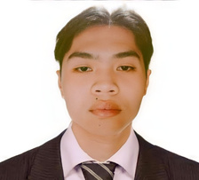
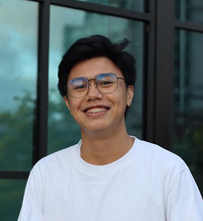
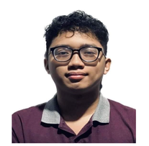
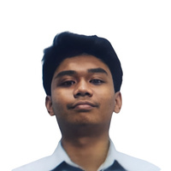
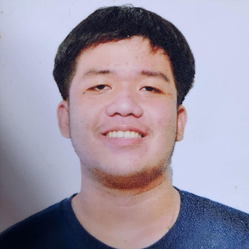
Team Composition
PENOLA, JOHN PAUL
LIBAG. JOSHUA
HERNANDEZ, MARK DAVID
AMBONG, VINCENT REDD
FERNANDEZ, LANCE CEDRICK
What makes us a good team to solve the problem we chose?
  We are a strong team because we combine diverse skills in operations, technology, finance, and marketing, led by a committed project leader who drives the work forward. As pet owners ourselves, we understand the struggles firsthand, making us passionate and well-positioned to deliver a trustworthy solution through Furriend.
Chief Executive Officer
Role/Position:
COO
Role/Position:
CTO
Role/Position:
CFO
Role/Position:
CMO
Key Strengths and abilities:
  Strong leadership and initiative (driving most of the project work).
  Skilled in research, data gathering, and market validation.
  Ability to design and organize surveys, interpret results, and turn insights into strategy.
  Excellent presentation and documentation skills.
  Multitasker – managing multiple aspects (concept development, analysis, and coordination).
  Passion for pets and empathy for customer needs (core to the product vision).
  Entrepreneurial mindset with creativity in problem-solving.
Key Strengths and abilities:
  Organized and detail-oriented; ensures smooth workflow.
  Good at managing schedules, deadlines, and task distribution.
  Coordinates between team members and keeps everyone accountable.
  Ability to streamline processes and improve efficiency.
Key Strengths and abilities:
  Knowledge in mobile app development and emerging tech.
  Strong problem-solving skills in technical design and implementation.
  Ability to evaluate tools, platforms, and security for the app.
  Passion for innovation and ensuring the app is user-friendly and reliable. :
Key Strengths and abilities:
  Skilled in financial planning, budgeting, and cost analysis.
  Good with numbers, ensures realistic revenue projections and sustainability.
  Manages allocation of funds for marketing, development, and operations.
  Ensures transparency and accountability in handling money.
Key Strengths and abilities:
  Strong communication and creativity in promoting the app.
  Skilled in branding, social media, and customer engagement.
  Can design campaigns to attract both sitters and pet owners.
  Ability to gather feedback and convert it into marketing insights.

Slide 30

References:
Dogster. (2024, April 18). 13 pet ownership statistics in the Philippines. Dogster. https://www.dogster.com/statistics/pet-ownership-statistics-philippines
Global Pet Industry. (2021, March 22). The pet industry in the Philippines. Global Pet Industry. https://globalpetindustry.com/news/the-pet-industry-in-the-philippines
Grand View Research. (2024). Philippines animal health market size, share & trends report, 2030. Grand View Research. https://www.grandviewresearch.com/horizon/outlook/animal-health-market/philippines
IMARC Group. (2024). Philippines pet food market: Industry trends, share, size, growth, opportunity and forecast 2024-2033. IMARC Group. https://www.imarcgroup.com/philippines-pet-food-market
U.S. Department of Commerce, International Trade Administration. (2021, August 13). Philippines upscale pet food and supplies. trade.gov. https://www.trade.gov/market-intelligence/philippines-upscale-pet-food-and-supplies
Survey conducted by authors. (2025, August 19–21). Pet sitting needs and challenges among Filipino pet owners. https://forms.gle/8xjpGSSuAevckezw6. Technological Institute of the Philippines.

